Slide 1

Audio-VISUAL SPEECH RECOGNITION
GROUP MEMBERS : TEJASWI KOTTAKKI - 2010030088
HARIKA NETHI - 2010030119
SHREYA CHINTAWAR - 2010030155
AMRUTHA VARSHINI - 2010030009
GUIDE
DR.ARPITA GUPTA

Slide 2
OUTLINE
Problem statement
Motivation
Objective
Literature Survey
Dataset
Flow Diagram
Pre-Processing
Models
Conclusion
References
AUDIO-VISUAL SPEECH RECOGNITION 04-03-2022 2

Slide 3
Problem statement
Communicating with hearing-impaired people is a little more demanding than speaking to a normal person.
Speech impaired people or people having low vocal range, find it difficult to communicate, as other people might not be able to understand.
Hearing and speech impairments can affect anyone, both children and adults.
AUDIO-VISUAL SPEECH RECOGNITION 04-03-2022 3

Slide 4
MOTIVATION
Speech reading helps to improve speech perception.
Hearing impaired people rely on lip reading for understanding the speech.
Audio - Visual speech recognition could positively impact the lives of hundreds of thousands of patients with speech and hearing impairments.
AUDIO-VISUAL SPEECH RECOGNITION 04-03-2022 4

Slide 5
OBJECTIVE
Assistive technology on speech-to-text conversion.
Lip reading architecture capture visual speech recognition
Speaker recognition under noisy and unconstrained conditions
AUDIO-VISUAL SPEECH RECOGNITION 04-03-2022 5

Slide 6
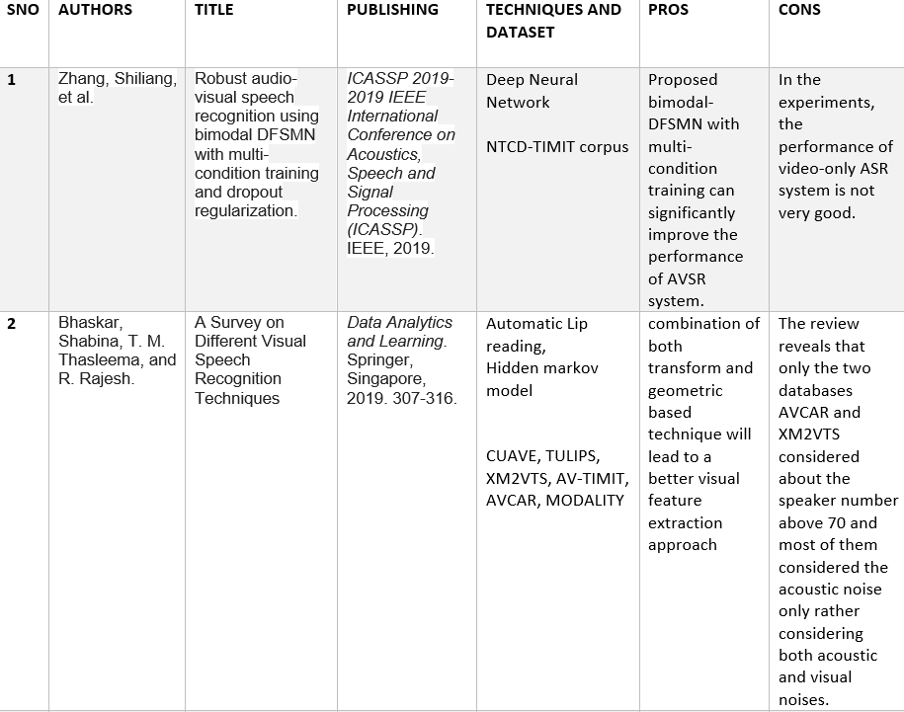
LITERATURE SURVEY
AUDIO-VISUAL SPEECH RECOGNITION 04-03-2022 6

Slide 7
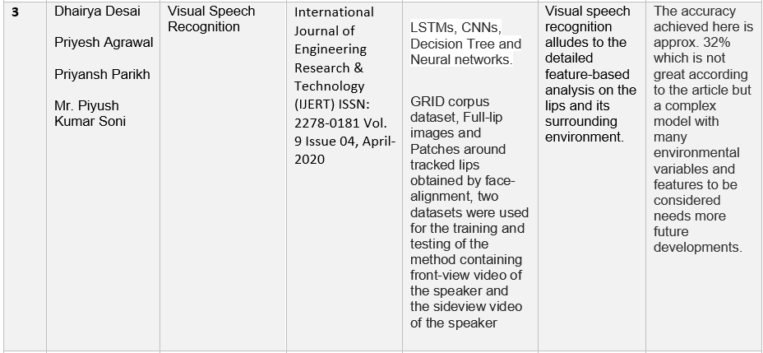
AUDIO-VISUAL SPEECH RECOGNITION 04-03-2022 7

Slide 8
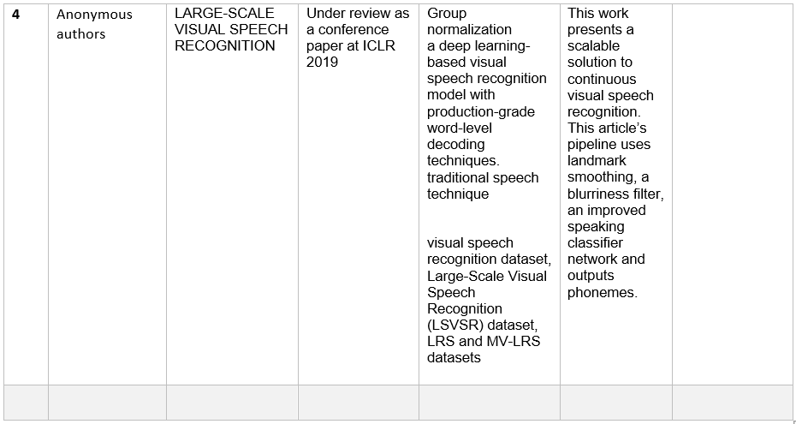
AUDIO-VISUAL SPEECH RECOGNITION 04-03-2022 8

Slide 9
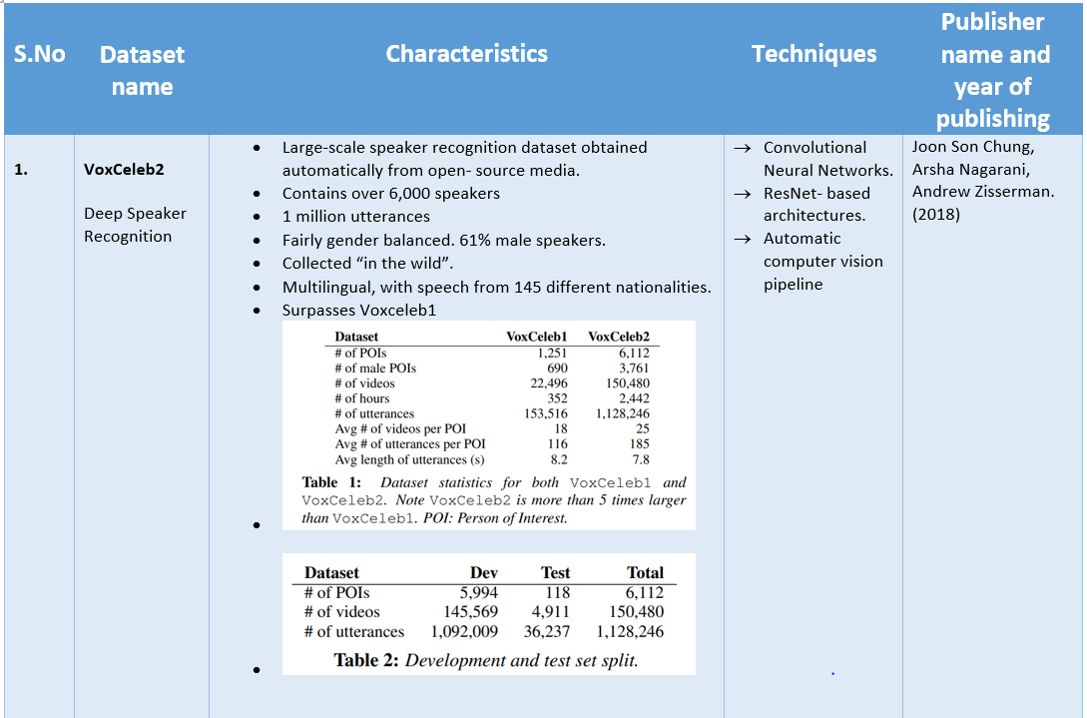
DATASET
AUDIO-VISUAL SPEECH RECOGNITION 04-03-2022 9

Slide 10
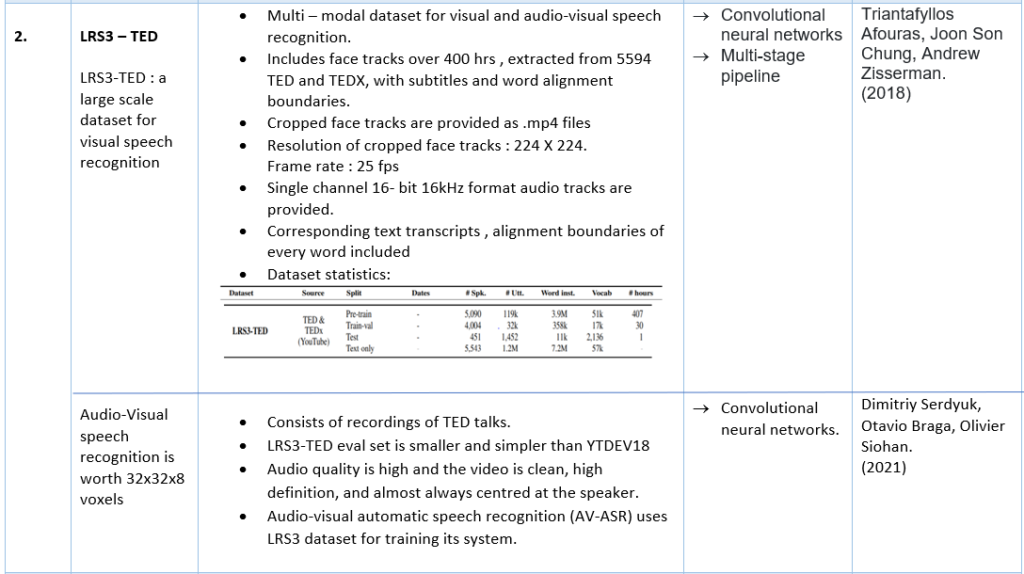
AUDIO-VISUAL SPEECH RECOGNITION 04-03-2022 10

Slide 11
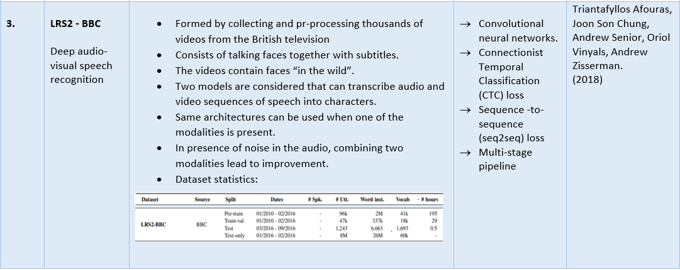
AUDIO-VISUAL SPEECH RECOGNITION 04-03-2022 11

Slide 12
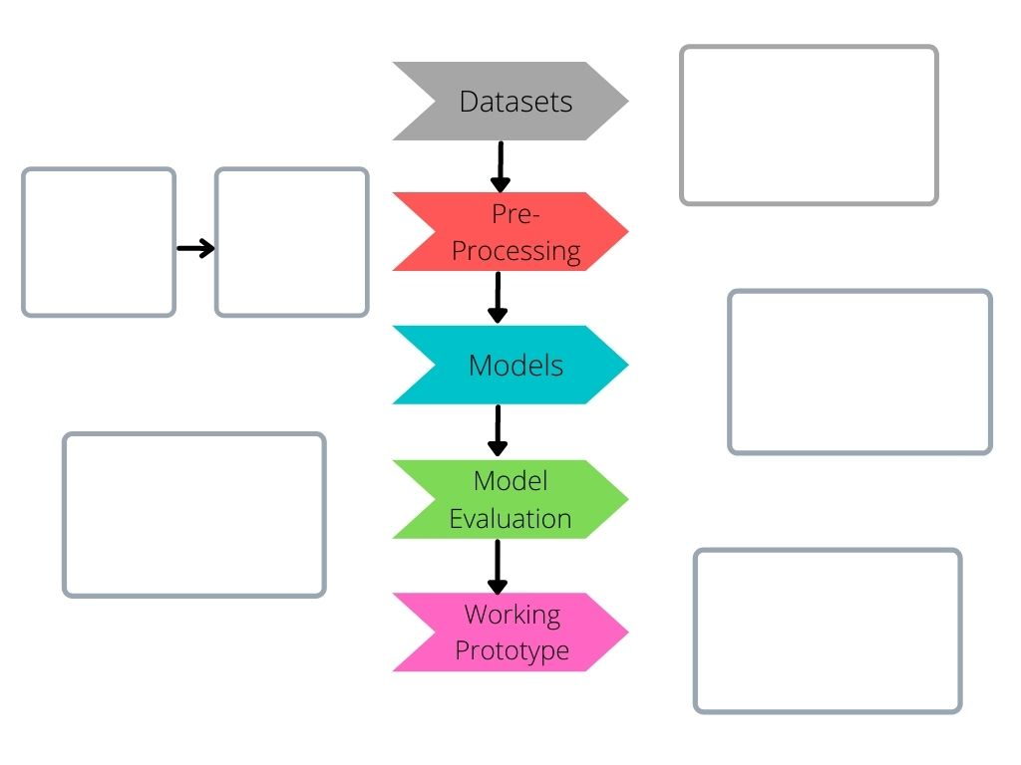
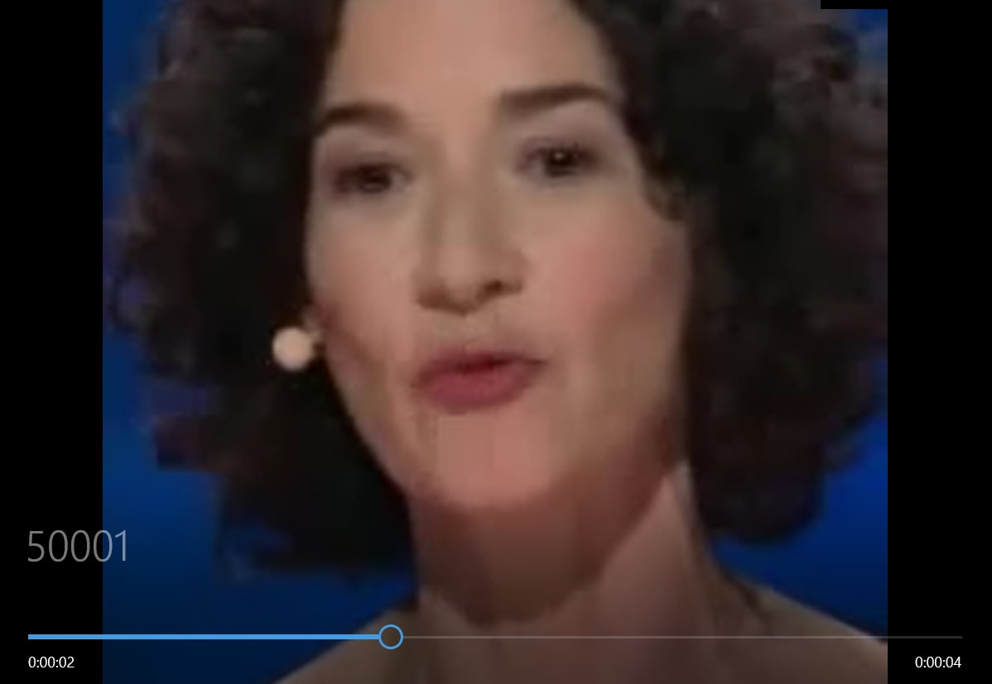
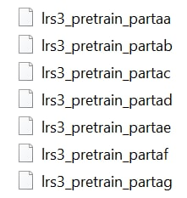

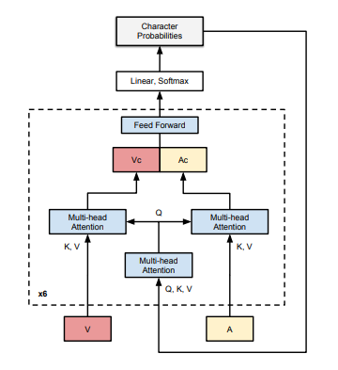
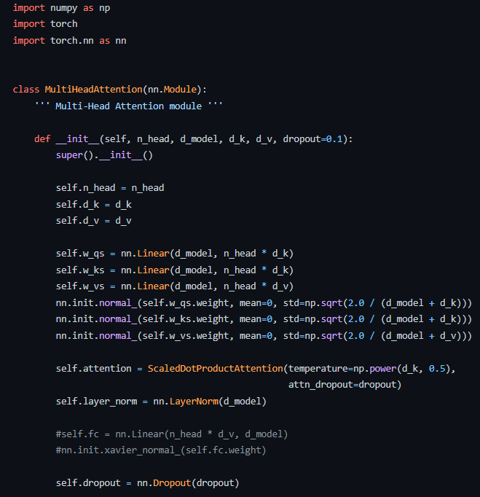
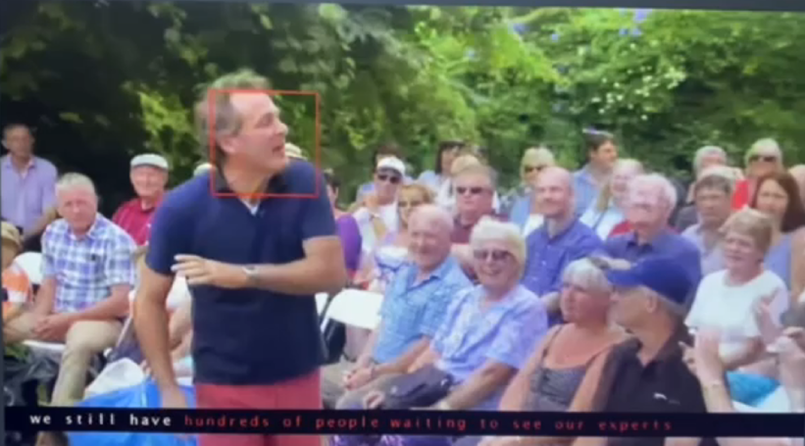
FLOW DIAGRAM
AUDIO-VISUAL SPEECH RECOGNITION 04-03-2022 12

Slide 13
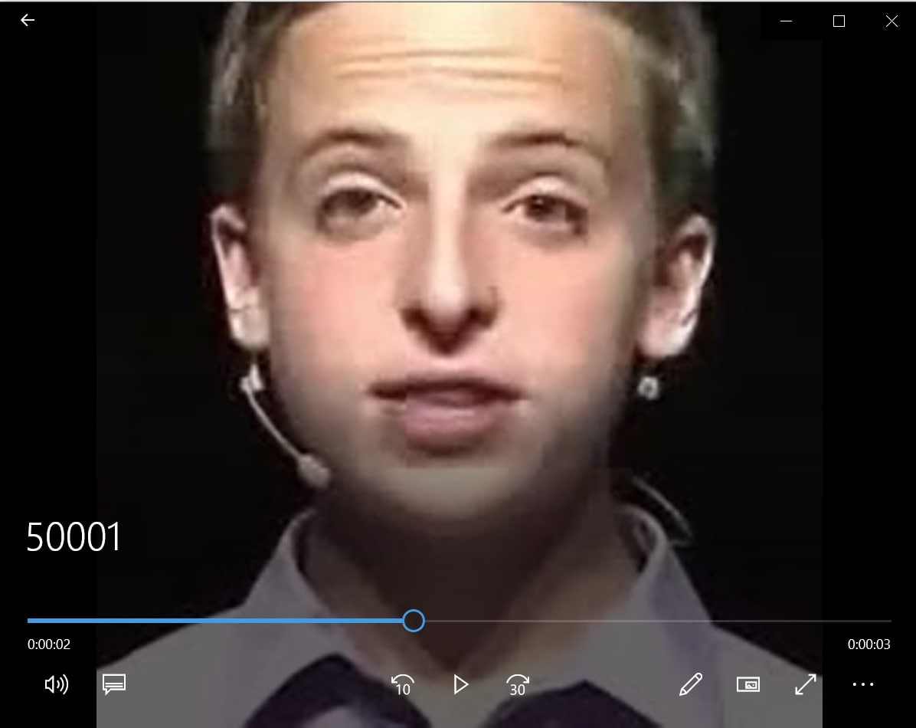
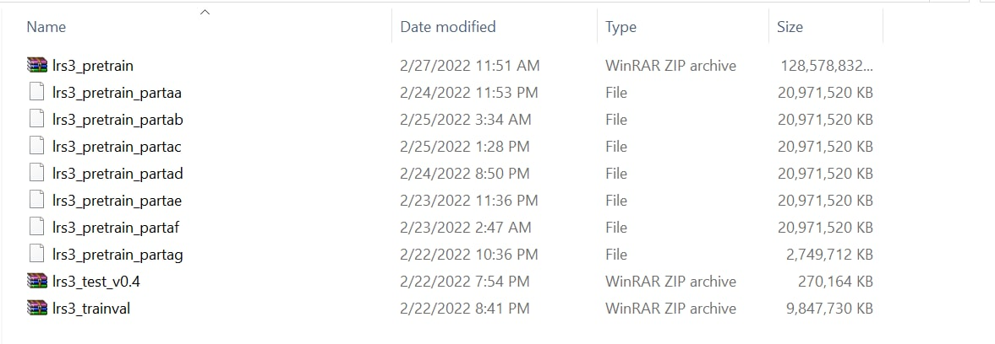
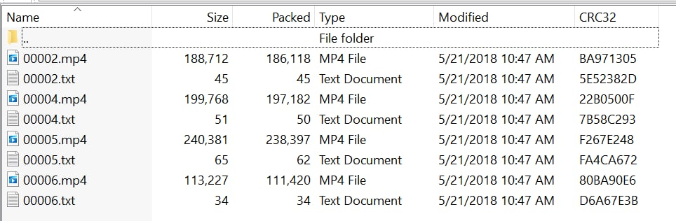
Step 1 - datasets
AUDIO-VISUAL SPEECH RECOGNITION 04-03-2022 13

Slide 14
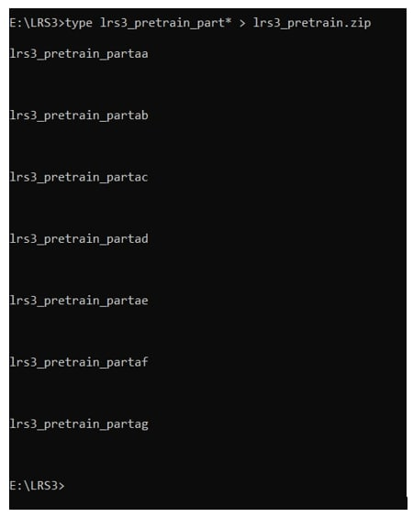
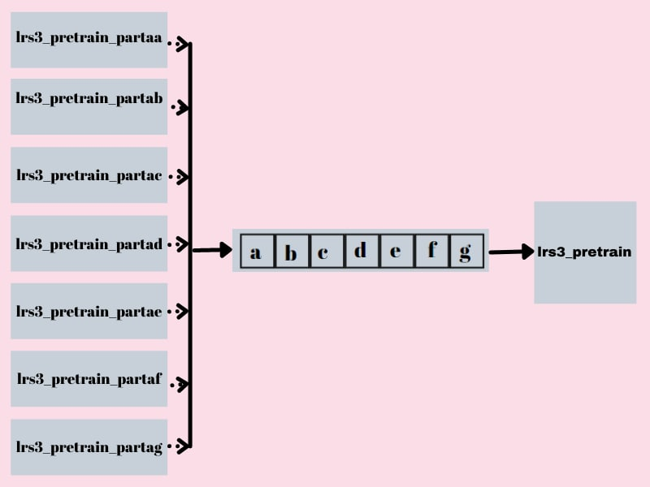
Step 2 - PRE-PROCESSING
Technique: Concatenation
AUDIO-VISUAL SPEECH RECOGNITION 04-03-2022 14

Slide 15
Step 3 - MODEL
TRANSFORMER SEQ2SEQ
AUDIO-VISUAL SPEECH RECOGNITION 04-03-2022 15

Slide 16
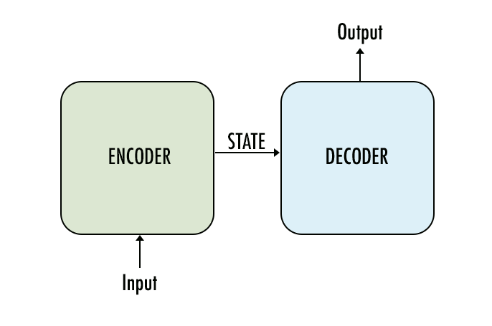
MODELS
Sequence to Sequence :
Sequence to Sequence (often abbreviated to seq2seq) models is a special class of Recurrent Neural Network architectures that we typically use (but not restricted) to solve complex Language problems like Machine Translation, video captioning, image captioning, Question Answering, creating Chatbots, Text Summarization, etc.
The most common architecture used to build Seq2Seq models is Encoder-Decoder architecture.
AUDIO-VISUAL SPEECH RECOGNITION 04-03-2022 16

Slide 17
Encoder-Decoder
Both encoder and the decoder are LSTM models
Encoder :
Encoder reads the input sequence and summarizes the information in something called the internal state vectors or context vector. We discard the outputs of the encoder and only preserve the internal states.
This context vector aims to encapsulate the information for all input elements in order to help the decoder make accurate predictions.
Decoder :
The decoder is an LSTM whose initial states are initialized to the final states of the Encoder LSTM, i.e. the context vector of the encoder’s final cell is input to the first cell of the decoder network. Using these initial states, the decoder starts generating the output sequence, and these outputs are also taken into consideration for future outputs.
AUDIO-VISUAL SPEECH RECOGNITION 04-03-2022 17

Slide 18
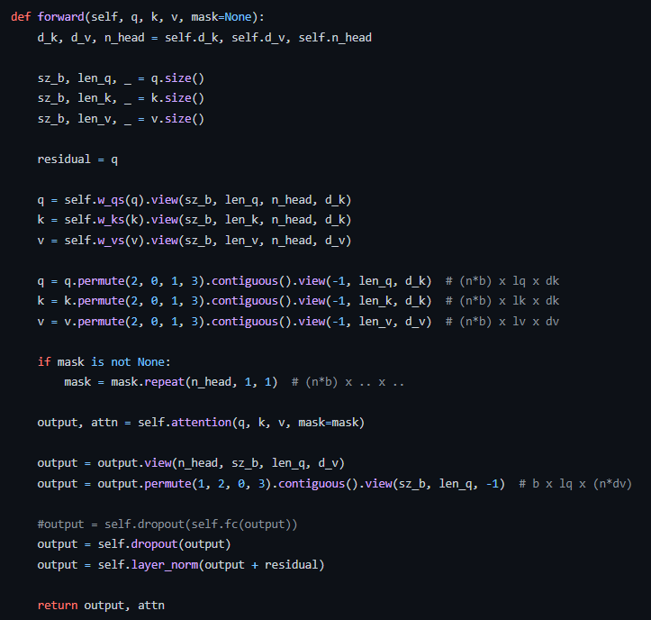
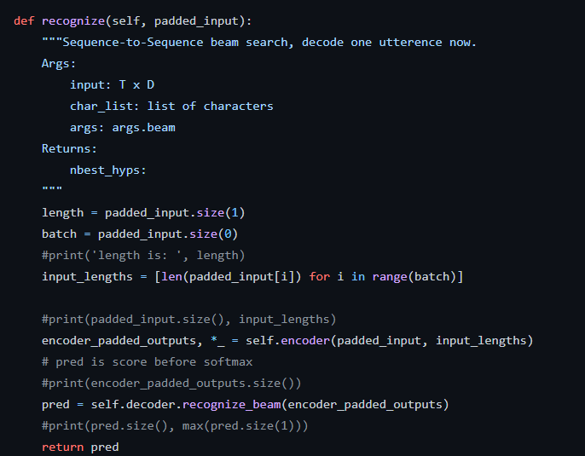
Step 4 – MODEL EVALUATION
AUDIO-VISUAL SPEECH RECOGNITION 04-03-2022 18

Slide 19
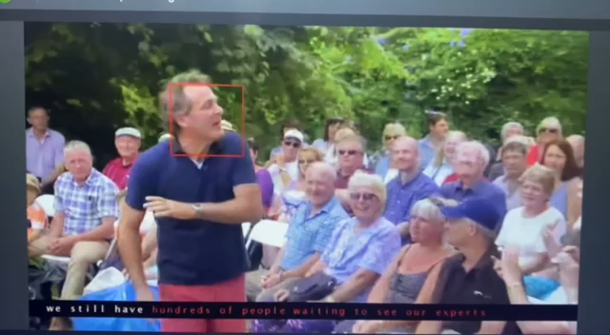
Step 5 – WORKING PROTOTYPE
AUDIO-VISUAL SPEECH RECOGNITION 04-03-2022 19

Slide 20
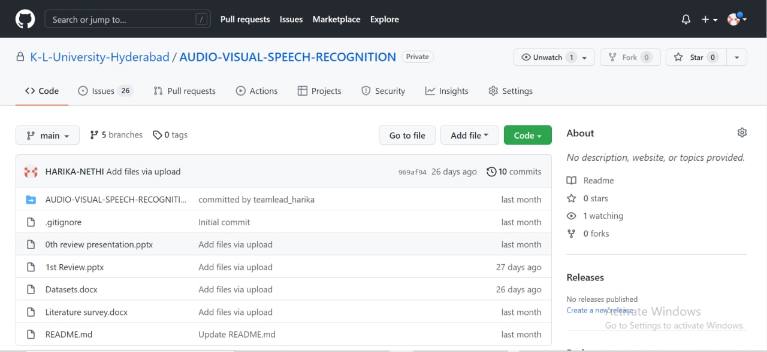
GIT-HUB COMMITS
AUDIO-VISUAL SPEECH RECOGNITION 04-03-2022 20

Slide 21
conclusion
This technology provides an alternative way of communication (i.e. Visual communication) for people with hearing or speech impaired problems.
Through this work we can recognize phrases and sentences being spoken by a talking face, with or without the audio.
We are exploring different datasets to create our own new working model.
AUDIO-VISUAL SPEECH RECOGNITION 04-03-2022 21

Slide 22
references
Zhang, Shiliang, Ming Lei, Bin Ma, and Lei Xie. "Robust audio-visual speech recognition using bimodal DFSMN with multi-condition training and dropout regularization." In ICASSP 2019-2019 IEEE international conference on acoustics, speech and signal processing (ICASSP), pp. 6570-6574. IEEE, 2019.
Bhaskar, Shabina, T. M. Thasleema, and R. Rajesh. "A Survey on Different Visual Speech Recognition Techniques." In Data Analytics and Learning, pp. 307-316. Springer, Singapore, 2019.
Desai, Dhairya, Priyesh Agrawal, Priyansh Parikh, and Mr. Piyush Kumar Soni. "Visual Speech Recognition." International Journal of Engineering Research & Technology (IJERT) 9, no. 04 (2020).
Shillingford, Brendan, Yannis Assael, Matthew W. Hoffman, Thomas Paine, Cían Hughes, Utsav Prabhu, Hank Liao et al. "Large-scale visual speech recognition." arXiv preprint arXiv:1807.05162 (2018)
AUDIO-VISUAL SPEECH RECOGNITION 04-03-2022 22

Slide 23
Chung, Joon Son, Arsha Nagrani, and Andrew Zisserman. "Voxceleb2: Deep speaker recognition." arXiv preprint arXiv:1806.05622 (2018).
Afouras, Triantafyllos, Joon Son Chung, and Andrew Zisserman. "LRS3-TED: a large-scale dataset for visual speech recognition." arXiv preprint arXiv:1809.00496 (2018).
Serdyuk, Dmitriy, Otavio Braga, and Olivier Siohan. "Audio-Visual Speech Recognition is Worth 32 x 32 x 8 Voxels." arXiv preprint arXiv:2109.09536 (2021).
Afouras, Triantafyllos, Joon Son Chung, Andrew Senior, Oriol Vinyals, and Andrew Zisserman. "Deep audio-visual speech recognition." IEEE transactions on pattern analysis and machine intelligence (2018).
AUDIO-VISUAL SPEECH RECOGNITION 04-03-2022 23

Slide 24
Afouras, Triantafyllos, Joon Son Chung, Andrew Senior, Oriol Vinyals, and Andrew Zisserman. "Deep audio-visual speech recognition." IEEE transactions on pattern analysis and machine intelligence (2018).
Afouras, Triantafyllos, Joon Son Chung, and Andrew Zisserman. "LRS3-TED: a large-scale dataset for visual speech recognition." arXiv preprint arXiv:1809.00496 (2018).
Mirzaei, Mohammad Reza, Seyed Ghorshi, and Mohammad Mortazavi. "Audio-visual speech recognition techniques in augmented reality environments." The Visual Computer 30, no. 3 (2014): 245-257.
AUDIO-VISUAL SPEECH RECOGNITION 04-03-2022 24

Slide 25
SUGGESTIONS
AUDIO-VISUAL SPEECH RECOGNITION 04-03-2022 25

